Slide 2

Why Automation?
Photo by davide ragusa on Unsplash

Slide 3

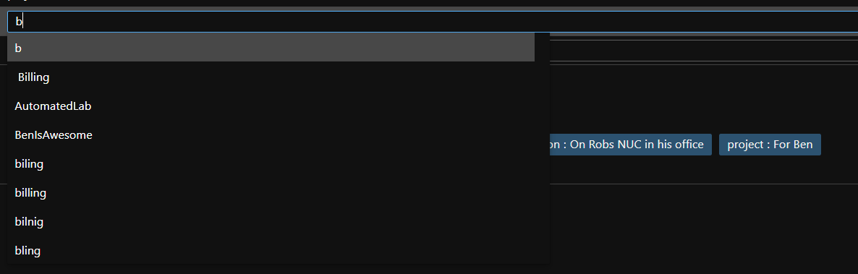
Unfortunately, we are fallible
We make mistakes
We can’t do the same thing 100 times reliably
Photo by Rob Curran on Unsplash

Slide 4

Where did I see that?
The idea for the previous slide came from the company YOU work for!

Slide 5

Computers will do the same thing everytime
Photo by Taylor Vick on Unsplash

Slide 6








Auditing
Cadence
Auditing provides accountability and visibility into changes
Improve the speed of doing the same thing again and again
Testing
Accountability
Testing ensures quality and identifies risks
Why was this change made? For what reason? Who approved it?
What Else?
Dashboards
Disaster Recovery
Dashboards provide pretty pictures for management
If the brown stuff hits the fan can we get back to work?
Repeatability
Documentation
DRY - Don't Repeat Yourself
Everyone loves documentation? Let's document as we go and better still if we can automate it

Slide 7
Auditing
Cadence
Auditing provides accountability and visibility into changes
Improve the speed of doing the same thing again and again
Testing
Accountability
Testing ensures quality and identifies risks
Why was this change made? For what reason? Who approved it?
What Else?
Dashboards
Disaster Recovery
Dashboards enable quick and easy view of important information
If the brown stuff hits the fan, can we get back to work?
Repeatability
Documentation
DRY - Don't Repeat Yourself
Everyone loves documentation? Let's document as we go and better still if we can automate it

Slide 8

First though some marketing

Slide 9

Azure DevOps
Continued heavy investment in Azure DevOps
Best in class CI/CD solution across the industry
Best & most loved solution for managing development teams
Tight integrations with GitHub
Provide enterprise scalable package management
➔
https://azure.com/devops

Slide 10





Deliver
with Azure DevOps
Azure Boards
Azure Repos
Azure Pipelines
Azure Artifacts
Azure Test Plans

Slide 11
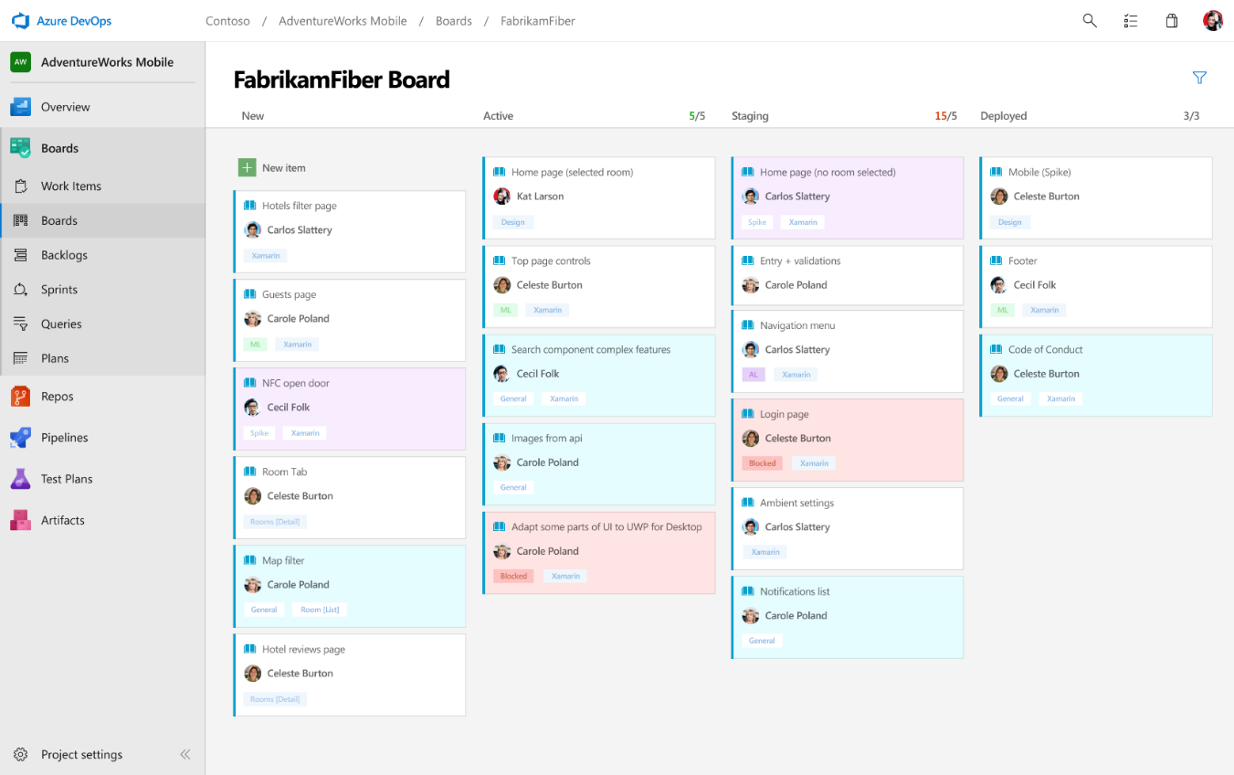
Deliver
Azure Boards
Azure Repos
Azure Pipelines
Connecting ideas to releases
Scrum ready to help your teams run sprints, stand-ups, and plan work
Integrated with GitHub commits and pull requests
Insights into project status and health
Azure Artifacts
Azure Test Plans

Slide 12
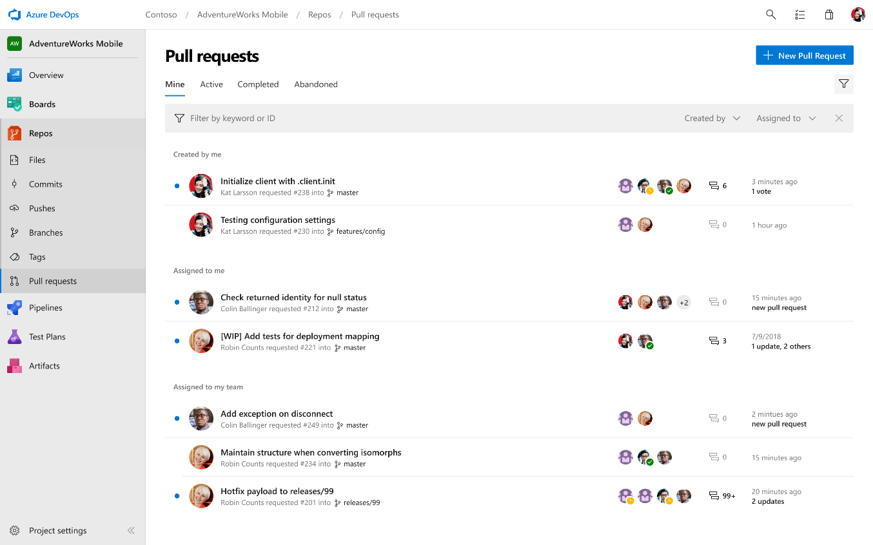
Deliver
Azure Boards
Azure Repos
Azure Pipelines
Private Git and TFVC repos for your teams
Code review via branch pull requests
Branch policies and build validation
Easy migration path to / from GitHub
Azure Artifacts
Azure Test Plans

Slide 13
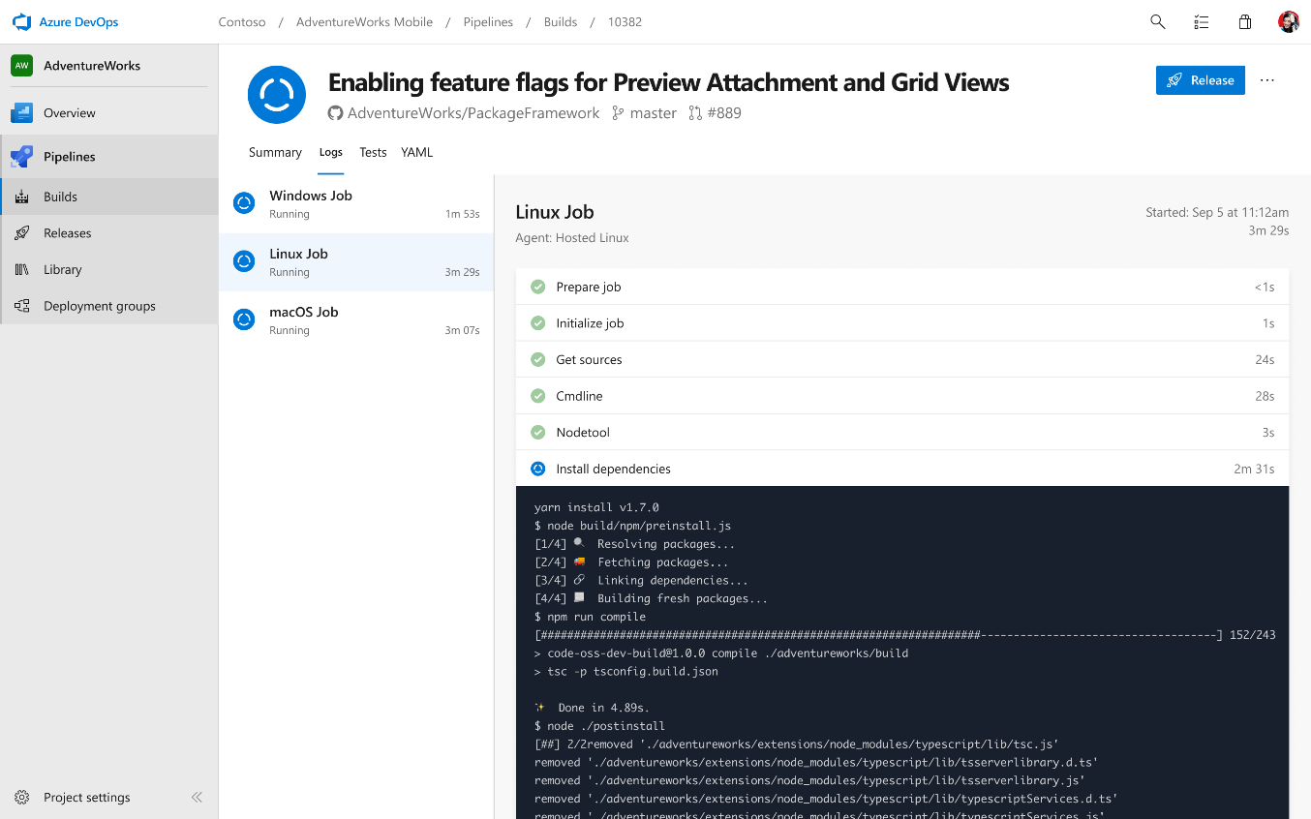
Deliver
Azure Boards
Azure Repos
Azure Pipelines
Cloud-hosted pipelines for Linux, macOS and Windows
Any language, any platform, any cloud
Native support for containers and Kubernetes
Best-in-class for open source
Azure Artifacts
Azure Test Plans

Slide 14
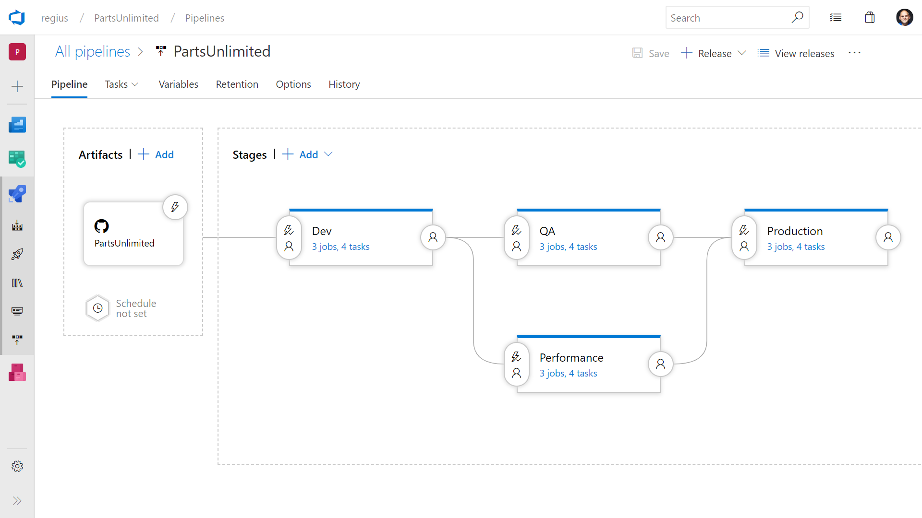
Deliver
Azure Boards
Azure Repos
Azure Pipelines
Deploy to on-premises, ANY cloud or a hybrid of cloud and on-prem
Staged environment releases
Pre and post deployment approvals with gates to automate approval based on conditions
Azure Artifacts
Azure Test Plans

Slide 15
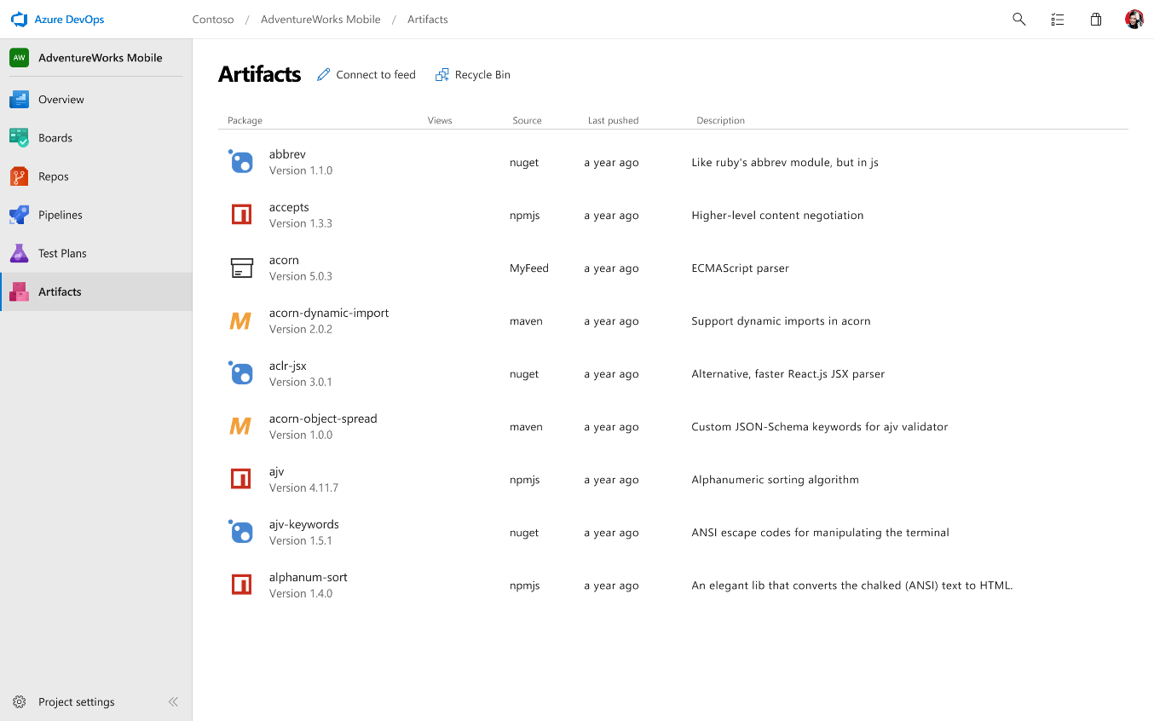
Deliver
Azure Boards
Azure Repos
Azure Pipelines
Share code efficiently
Keep your Maven, npm, NuGet and Python packages and more in the same place
Aggregate from public registries and internal teams
Publish and track from any pipeline
Azure Artifacts
Azure Test Plans

Slide 16
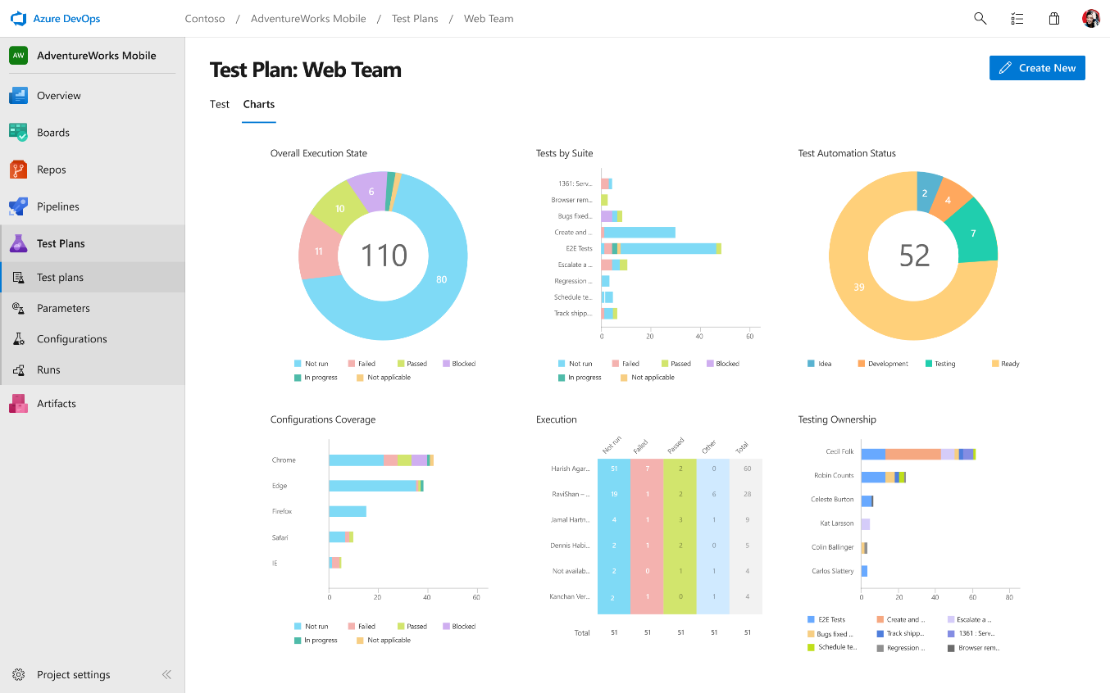
Deliver
Azure Boards
Azure Repos
Azure Pipelines
Run tests and log defects from your browser
Track and assess quality throughout your lifecycle
Capture rich data for reproducibility
Create tests directly from exploratory sessions
Azure Artifacts
Azure Test Plans

Slide 17



Azure Boards
#AzureBoards
aka.ms/azureboards
@AzureDevOps
Notes:
Join the conversation.
Potentially replace for speaker contact details / intro.

Slide 18

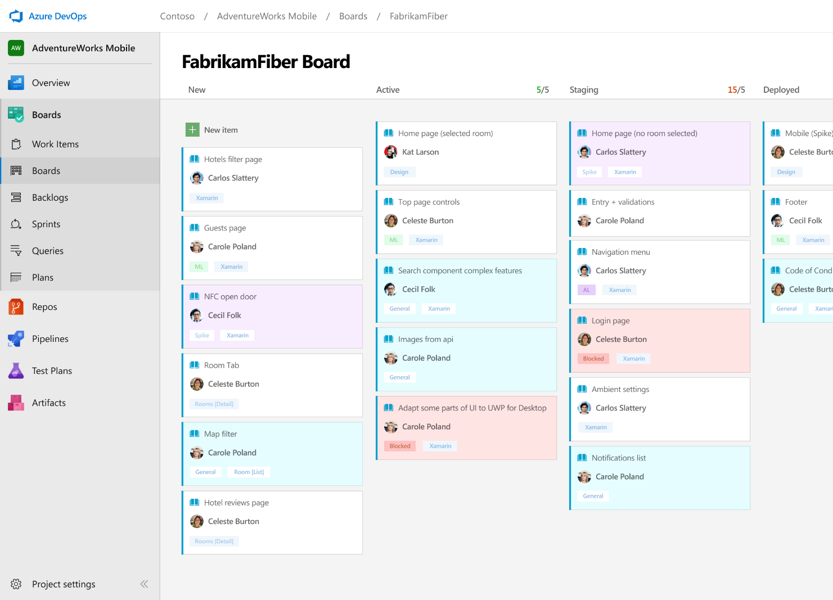



Azure Boards
Track work with Kanban boards, backlogs, team dashboards, and custom reporting.
Connected from idea to release
Track all your ideas at every development stage and keep your team aligned with all code changes linked directly to work items.
Scrum ready
Use built-in scrum boards and planning tools to help your teams run sprints, stand-ups, and planning meetings.
Project insights
Gain new insights into the health and status of your project with powerful analytics tools and dashboard widgets.
Notes:
Combine Kanban boards and drag-and-drop sprint planning with comprehensive traceability and reporting for the perfect home for all your ideas–big and small.

Slide 19
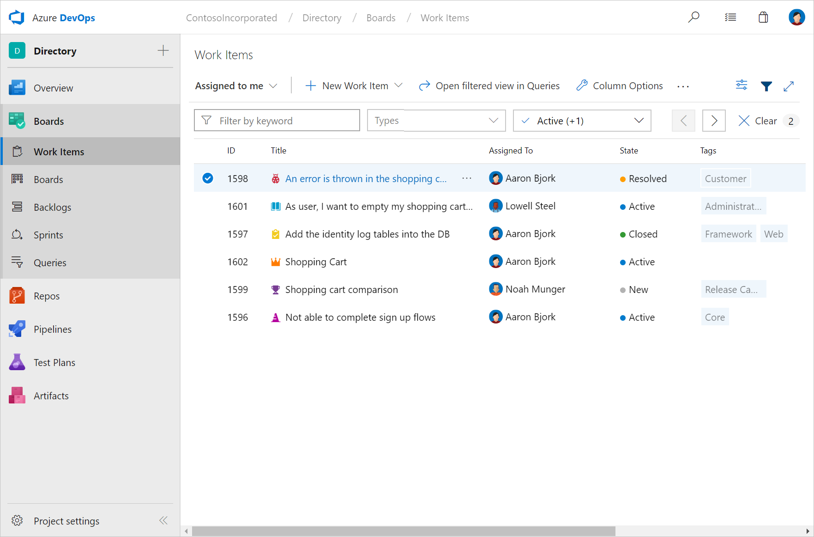

Work Items Hub
Use work items to find and focus on work you care about.

Find work items assigned to you
Track work items that you’re following or have viewed or modified recently.

Rich filtering
Filter work items on types, assignment, states, area, and tags.
Query and Search work items
Query work items within your project or across projects.
Notes:
Mention how queries can also be used to generate charts. Charts provide a preview of what can be pinned to the dashboard.
VSTS Open in Excel for bulk editing of work items
https://marketplace.visualstudio.com/items?itemName=blueprint.vsts-open-work-items-in-excel

Slide 20
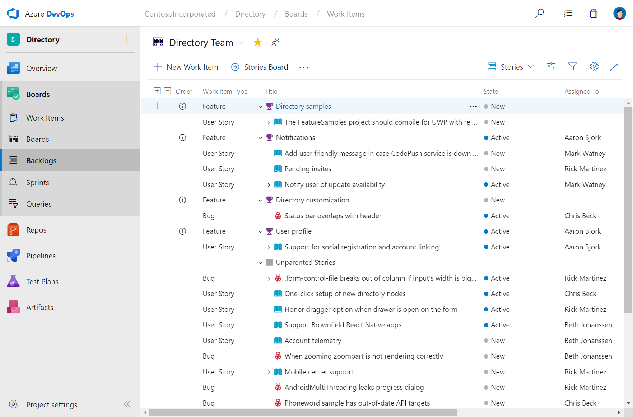
Backlogs Hub
Use your product backlog to quickly plan and prioritize your work.

Prioritize work items
Drag and drop items to adjust the order to help keep things in order of priority.

Manage relationships with hierarchy
After you’ve added features or epics to your portfolio backlog, you can map backlog items to them.
Plan sprints
Use the Plan Sprints pane to quickly assign work to an upcoming sprint.

Slide 21
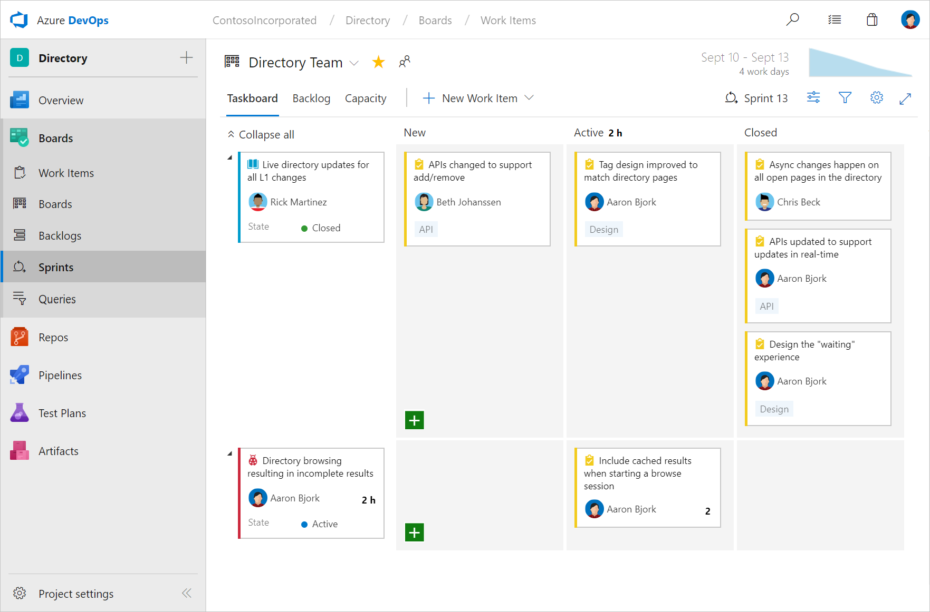

Sprints Hub
Sprints give you the ability to create increments of work for your team to accomplish together.
Taskboard
Use the taskboard in daily Scrum meetings to view progress made to backlog items and tasks.

Capacity Planning
Assign work hours to team members to help you and your team deliver your work on time.
Burndown Chart
Throughout your sprint, you can monitor the sprint burndown chart to determine if your team is on track to complete its sprint plan.

Slide 22
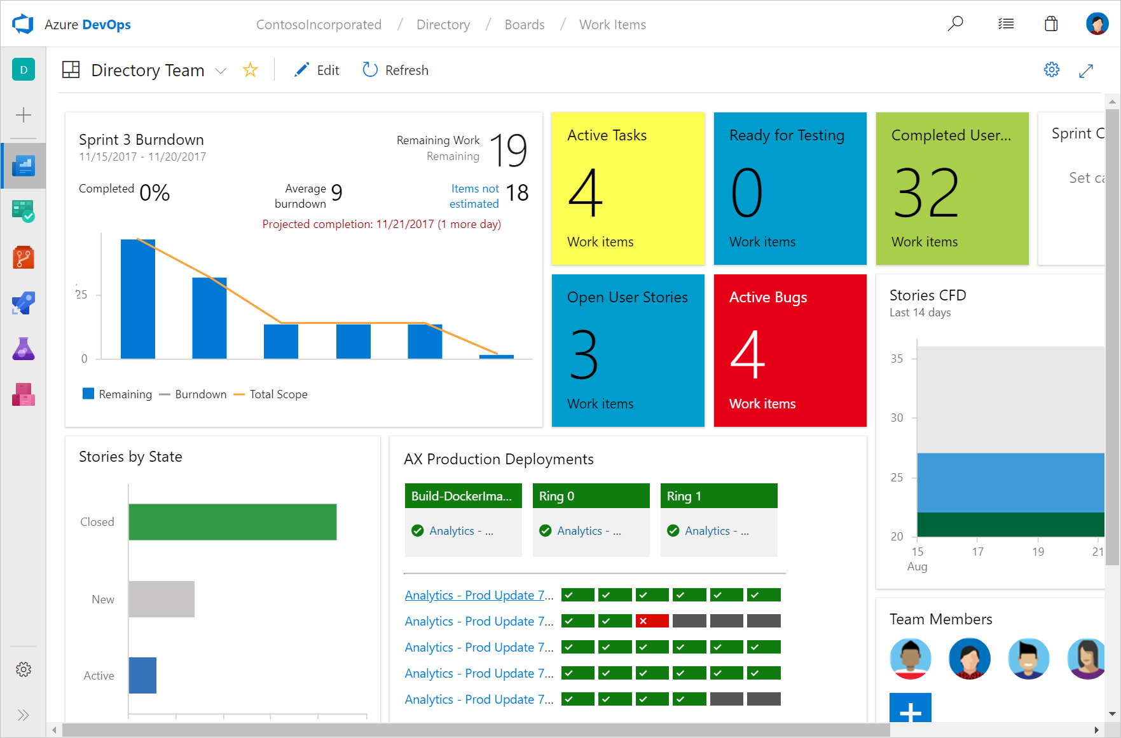


Dashboards
Dashboards give a clear view of what’s happening to track progress and direction.
Real-time information
Dashboards provide easy-to-read, easy access, real-time information
Thriving community of widgets
Widgets smartly format data to provide access to easily consumable data. Add widgets to your team dashboards to gain visibility into the status and trends occurring as you develop your software project.

Add dashboards as needed
Tailor configure the layout that makes sense for your team, and easily monitor progress throughout the lifecycle of your project.

Slide 23
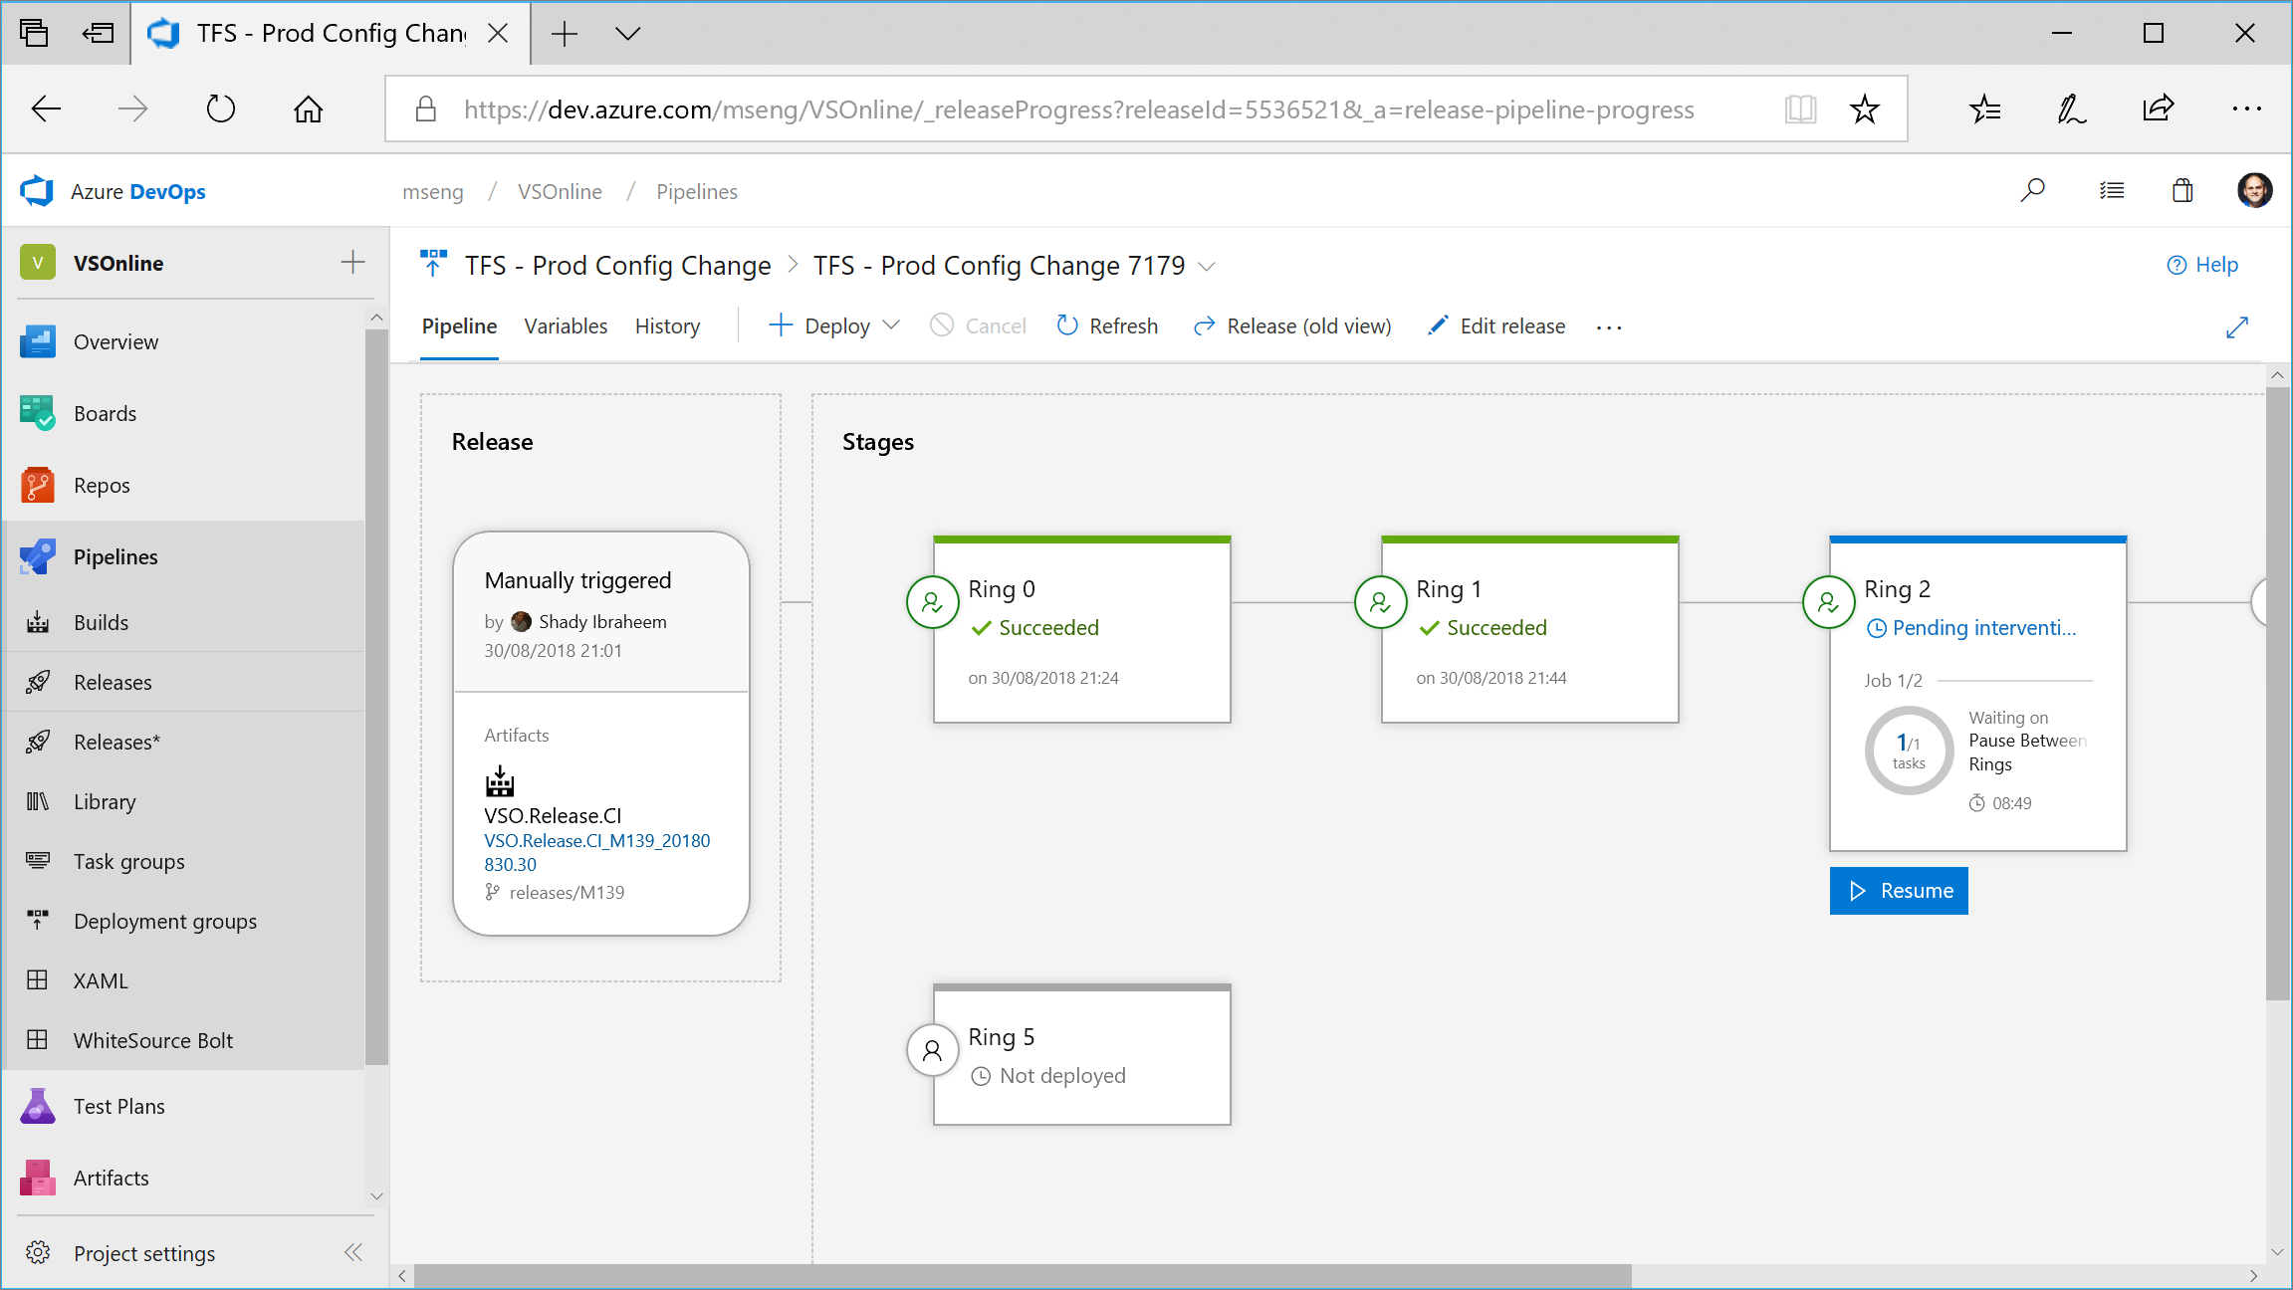
Notes:
We use Azure DevOps to deploy Azure DevOps (and build and deploy all the large products in Microsoft, from Windows to Office, Minecraft to Teams)

Slide 24
Expand your mind

Slide 25

What Is The Problem ?
Photo by Andrey Metelev on Unsplash

Slide 26
What Is The Problem ?
Automate a solution to make it easy for the Operational Team to control permissions to the Azure SQL Database and Azure SQL Managed Instance estate
Photo by Andrey Metelev on Unsplash

Slide 27
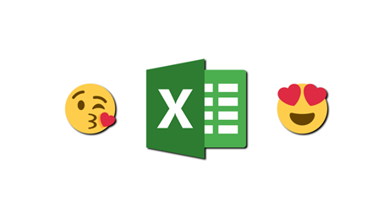
Also
“We’d Really like to use Excel”

Slide 28
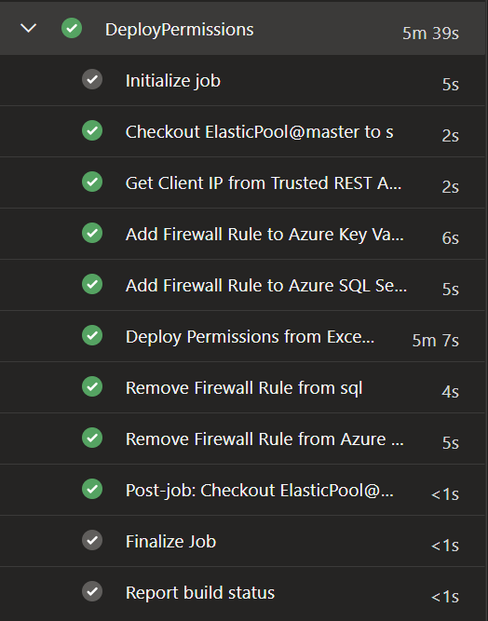
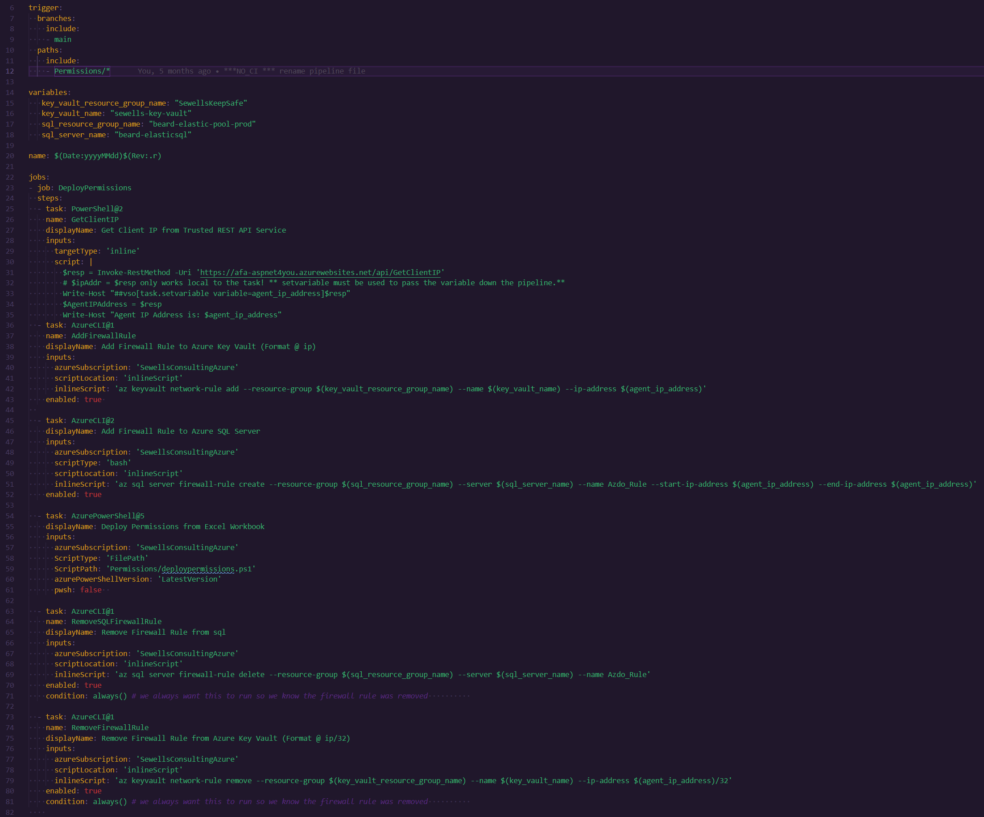
pipeline

Slide 29
pipeline

Slide 30
pipeline

Slide 31
pipeline

Slide 32
pipeline

Slide 33
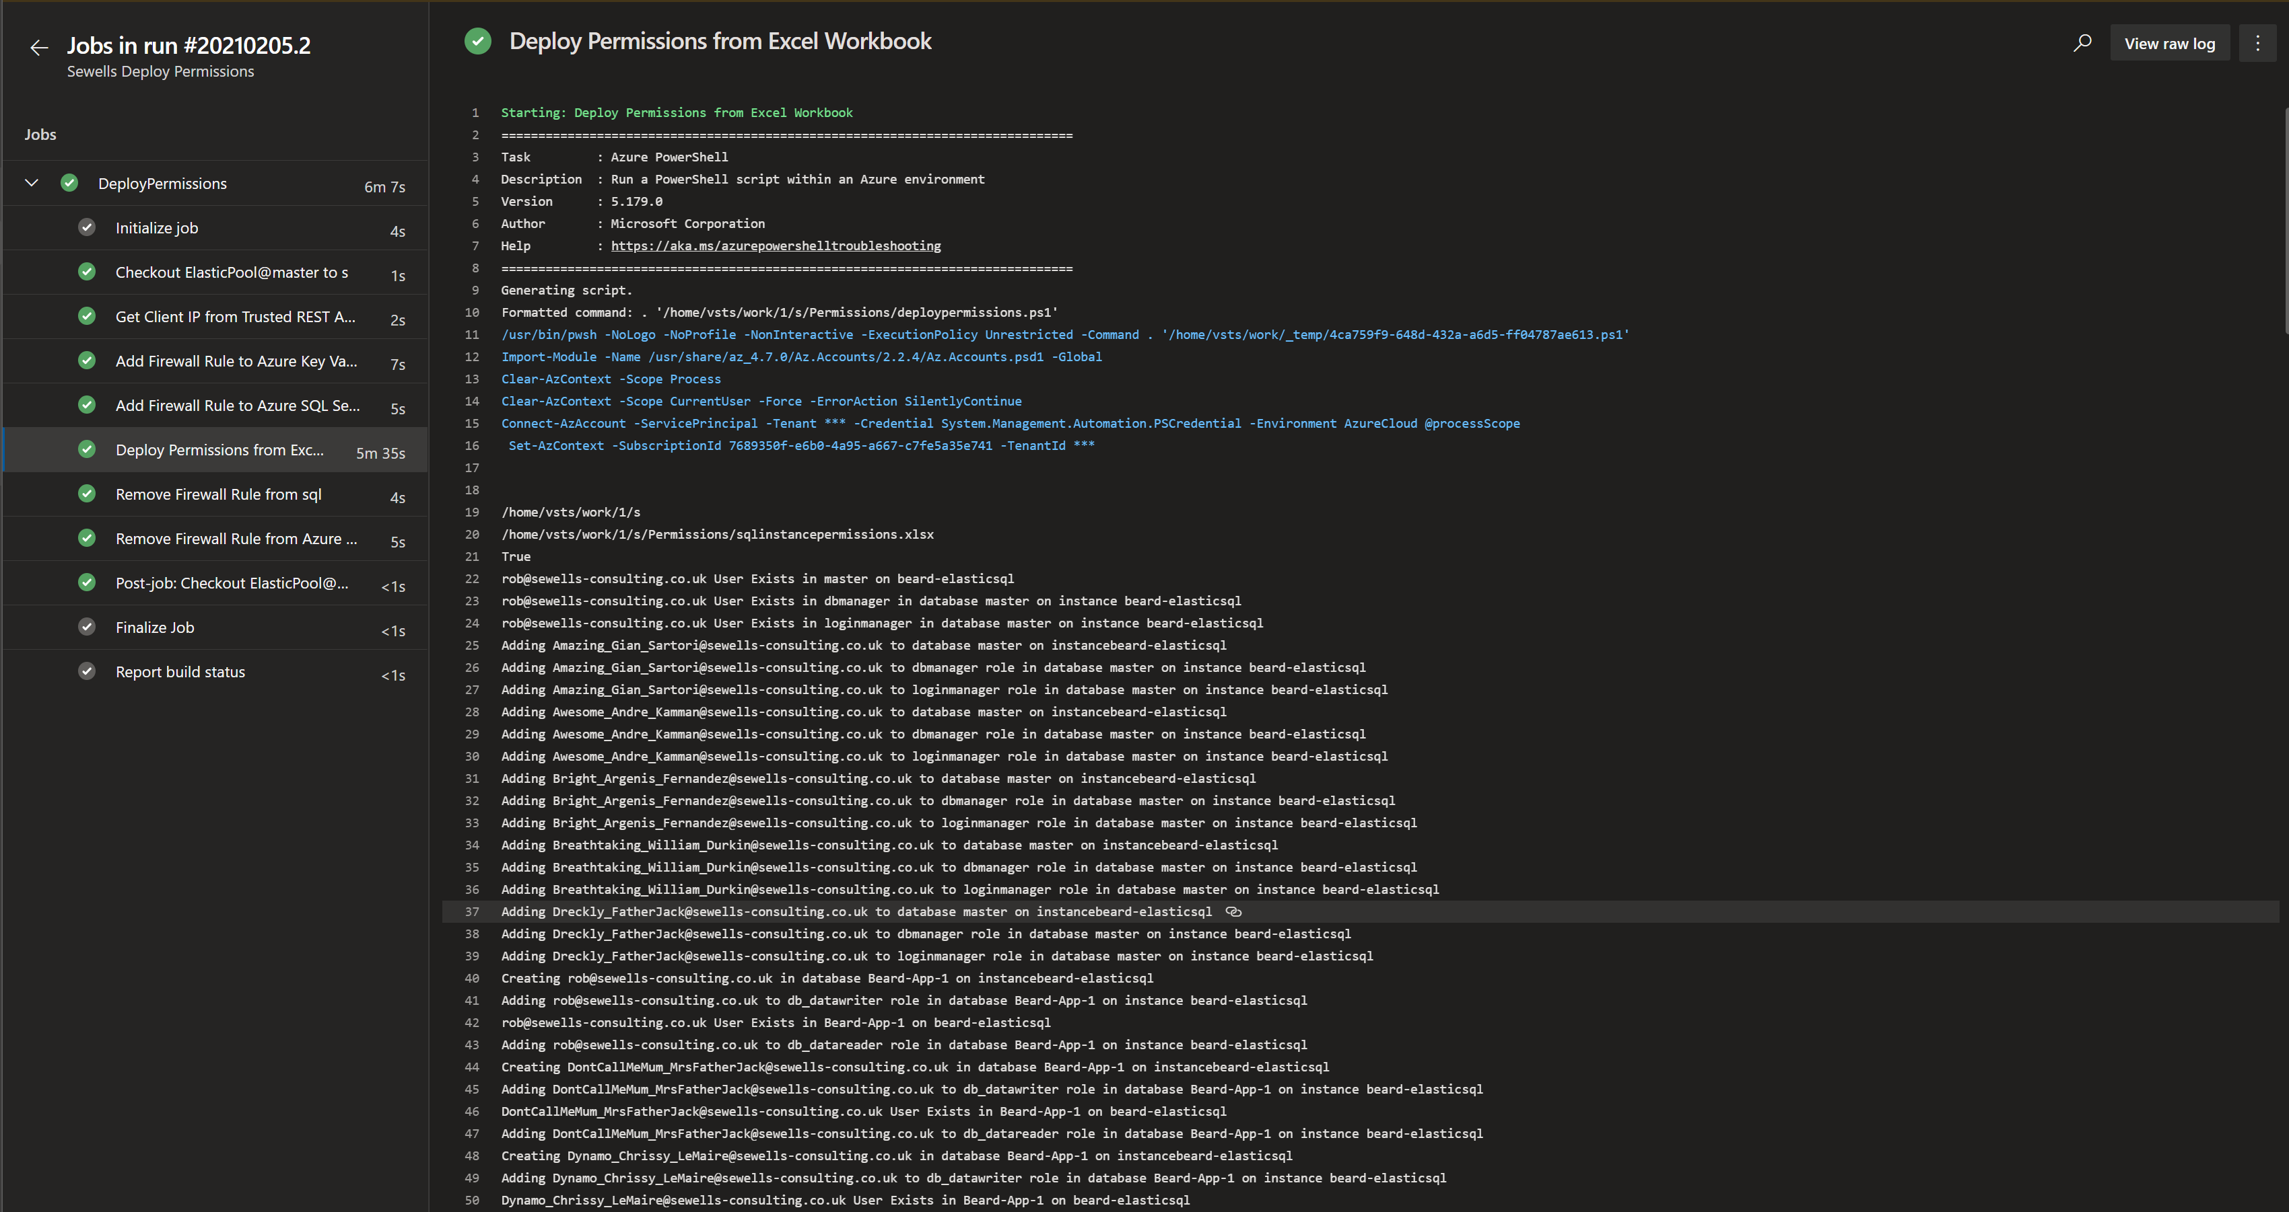
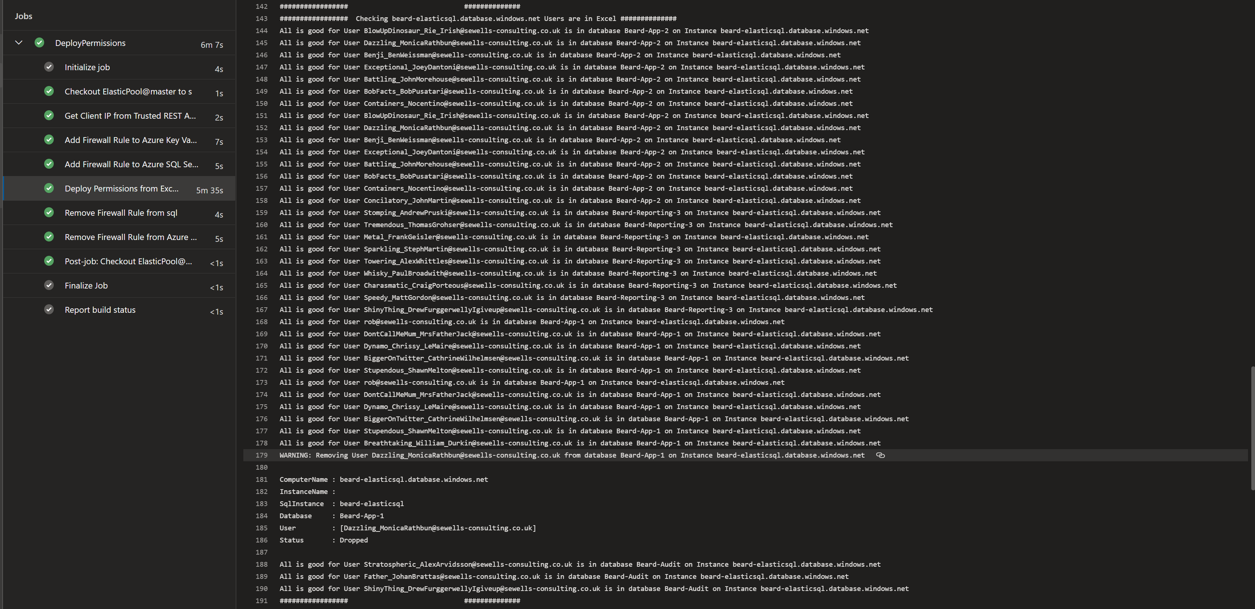
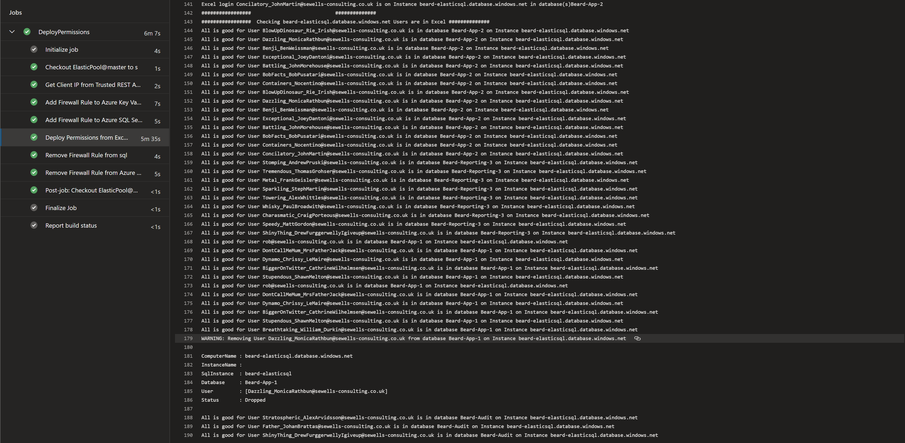
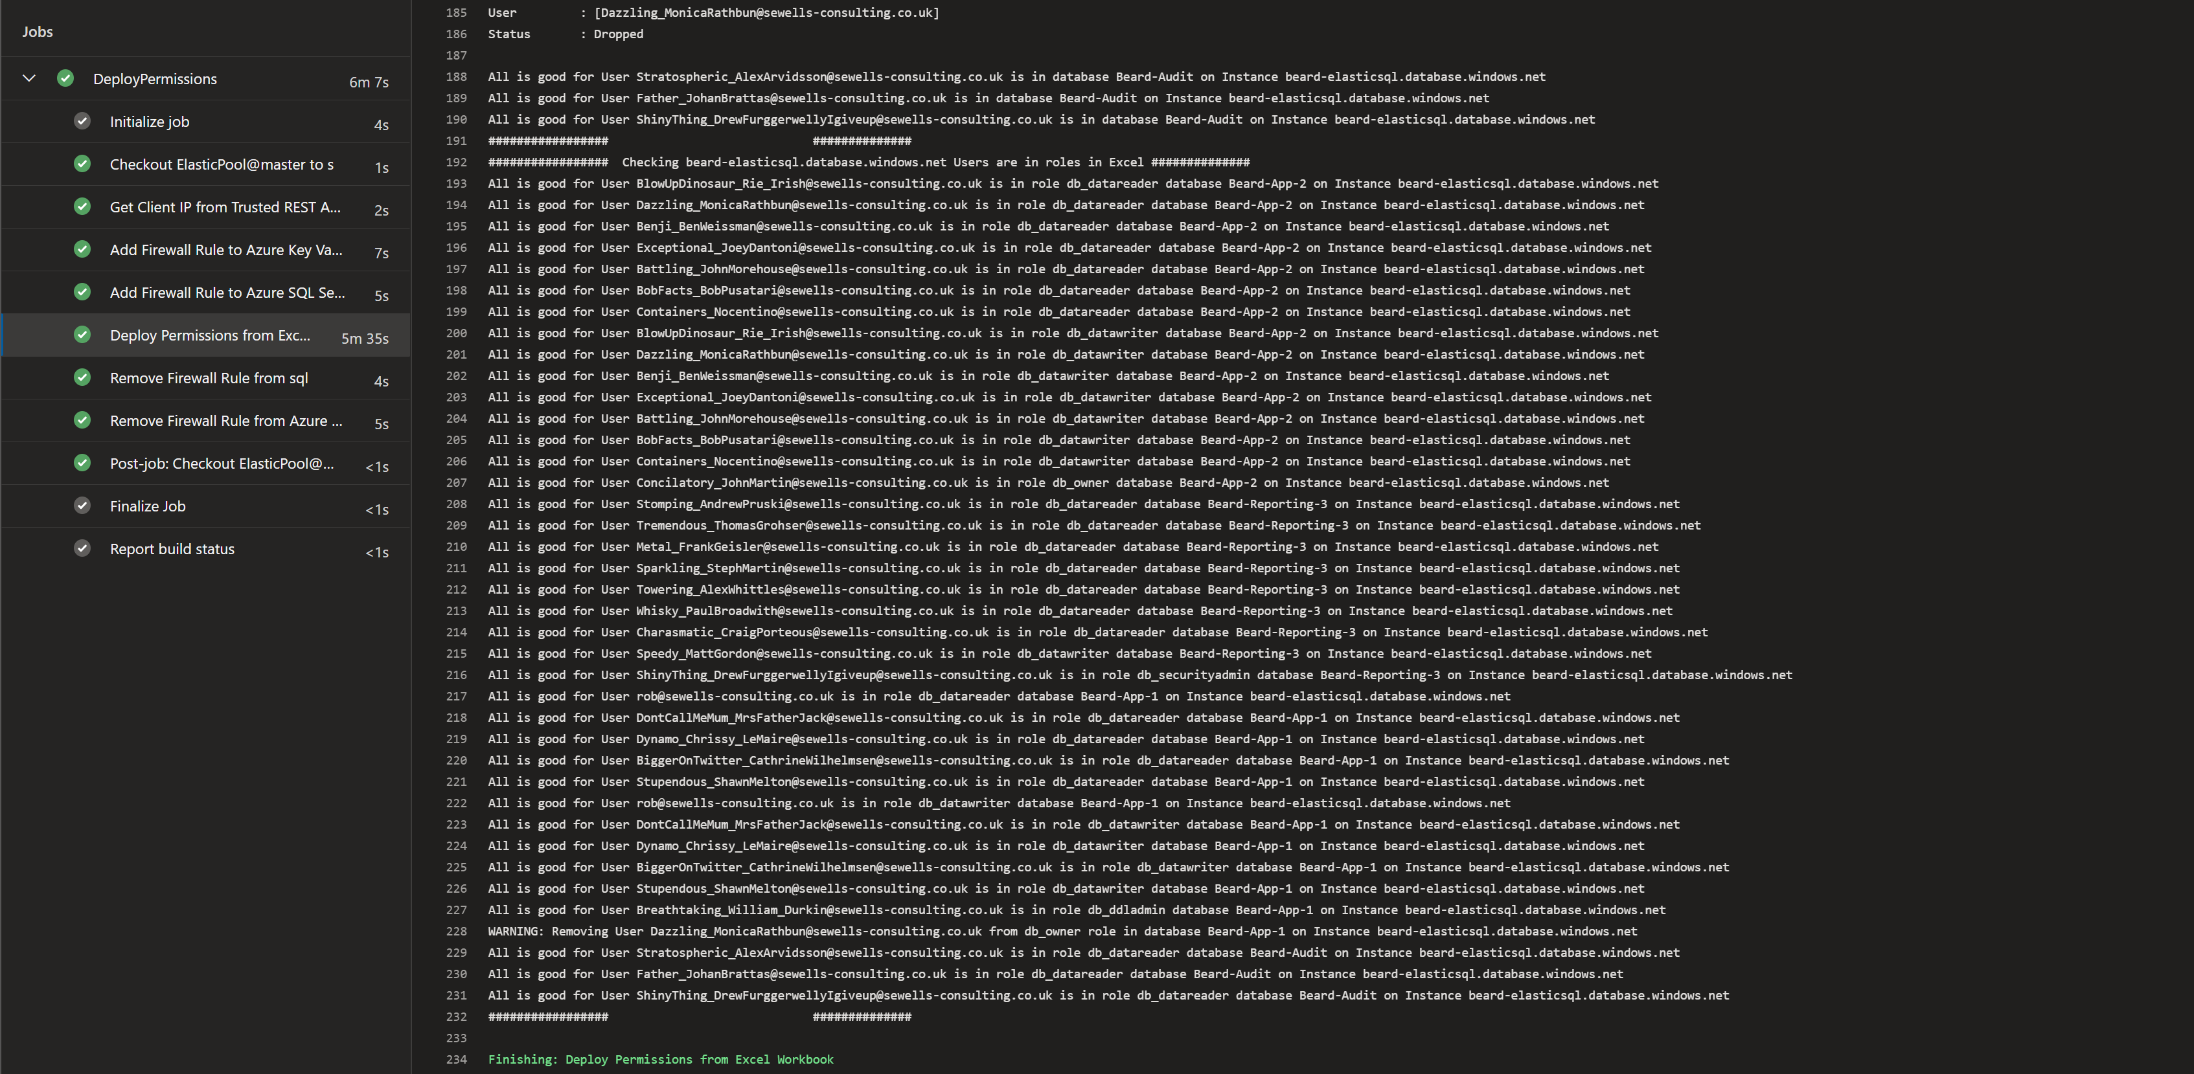
pipeline

Slide 34
pipeline

